Slide 1

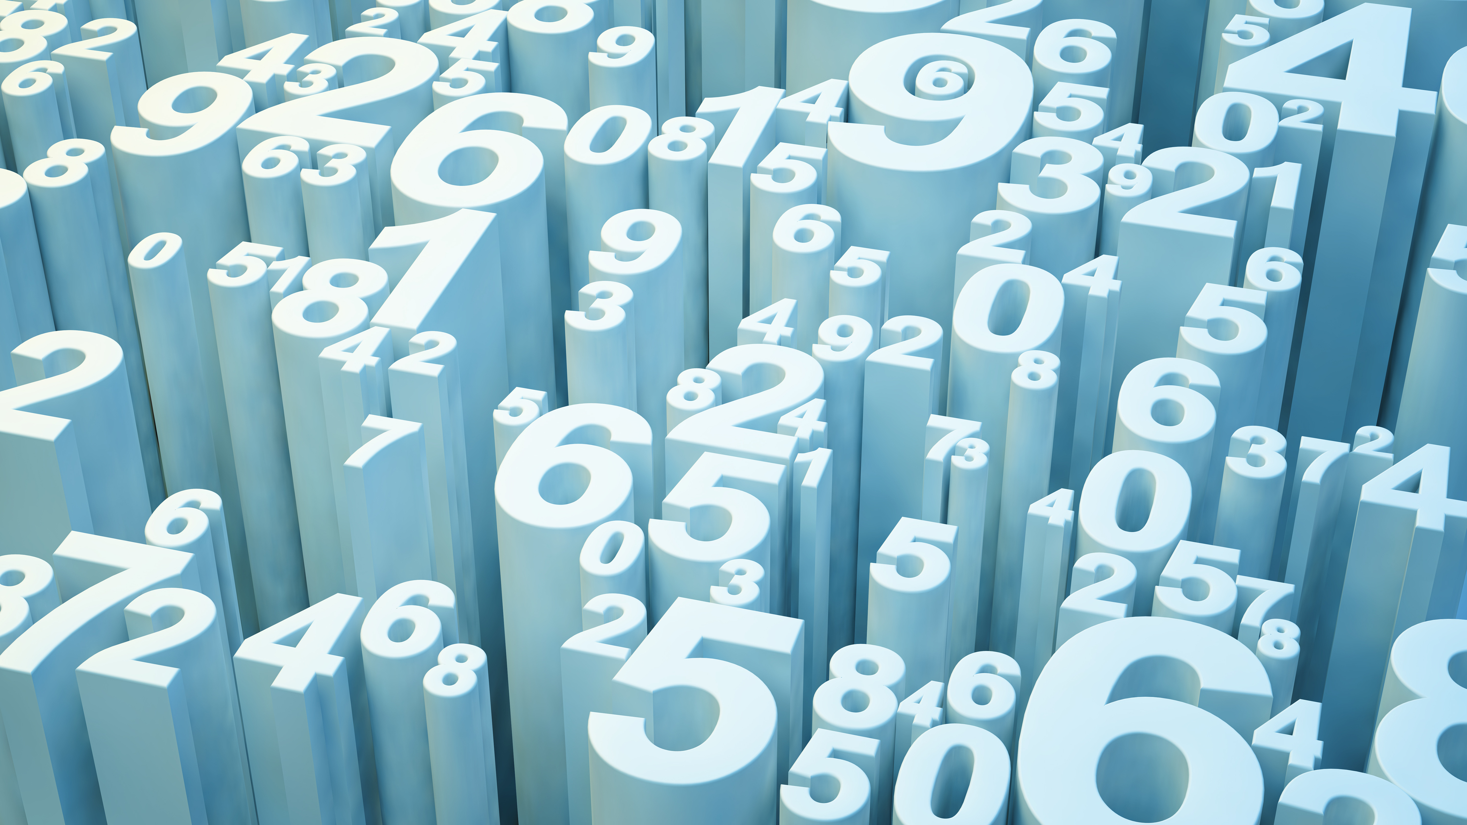
Micro Credit Defaulter Project
FLIPROBO TECHNOLOGIES
CREATED BY
VINAY SAHI

Slide 2
INTRODUCTION
Microfinance is widely accepted as a poverty-reduction tool, representing $70 billion in outstanding loans and a global outreach of 200 million clients. A telecommunications network provider is collaborating with an MFI to provide micro-credit on mobile balances to be paid back in 5 days. The Consumer is believed to be defaulter if he deviates from the path of paying back the loaned amount within the time duration of 5 days .The sample data is provided I am going to Build a model which can be used to predict in terms of a probability for each loan transaction, whether the customer will be paying back the loaned amount within 5 days of insurance of
As the client has been into telecom industry and now venturing into financial market in association with MFI. It will be a great combination as MFI has been into financial market with all that experience put together telecom and finance will do potentially well. The data will help me understanding the pattern of customers
Features like how long the customers has been with the company ,how often does he recharge the pack ,how many days he takes to return the credit.

Slide 3
Table Of Content
Data Sources and their formats
Data Pre-processing
Hardware and Software Requirements
EDA and Visualisation
Model Comparison
Potential Benefits

Slide 4
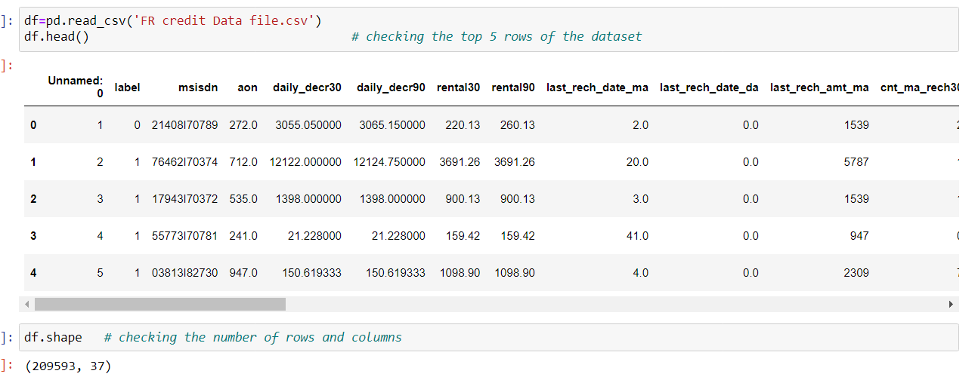
Data Sources and their formats
The data is been provided by fliprobo ,the dataset is in csv format, it has 209593 rows and 37 columns The feature includes a target variable which is a binary column consist of 0 or 1 . Independent variable includes last recharge date in days ,last recharge amount of last 30 /90 days ,total loan amount and so on.The data does not have any null values.

Slide 5
Data Pre-processing
SMOTE- This data has unbalanced data in target variable ,As this is a classification problem ,smote has been used to balance the data so machine can learn best way possible.
DROP- drop method has been used to drop useless column.
DATE TIME- to_datetime has been used to convert the object type data into datetime.
FEATURE SELECTION- feature selection technique has been used to find out best features with most information gain.

Slide 6
Hardware and Software Requirements
Hardware and Software Requirements
Hardware used-
Dell laptop with 500 GB SSD, intel icore processer i5 11th generation with 8 GM RAM.
Software requirements along with the tools, libraries and packages used
PythoN,Pandas,numpy,matplotlib ,seaborn , Extra tree classifier ,scikit learn

Slide 7
EDA and Visualisation
EDA has been performed to understand the data well, Visualisation has been done to understand data behaviour, correlation with heatmap has given understanding of corelation between variables and duplicity.feature selection has been performed to get the idea which variable is providing the best information gain, target variable has been balanced with smote technique,classification algorithms has been applied to build a predictive model to predict whether the customer will be paying back the loaned amount within 5 days .

Slide 8
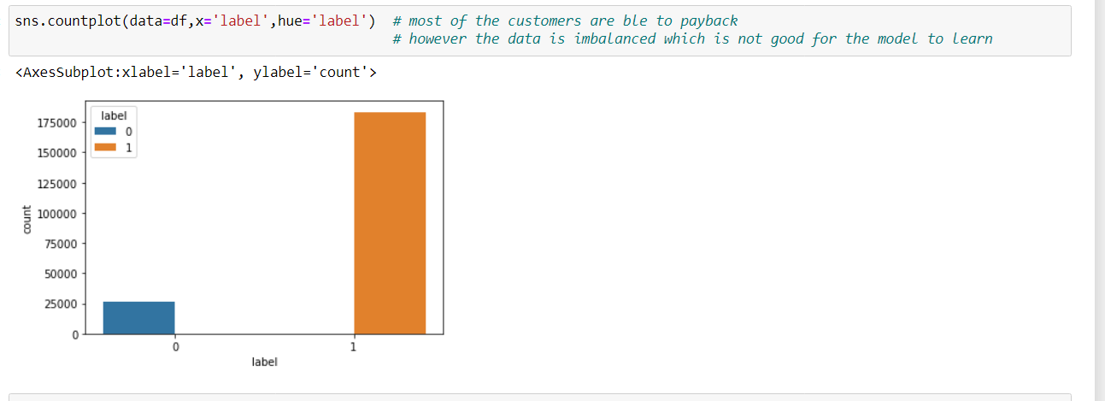
Countplot showing number of customers as defaulter or not

Slide 9
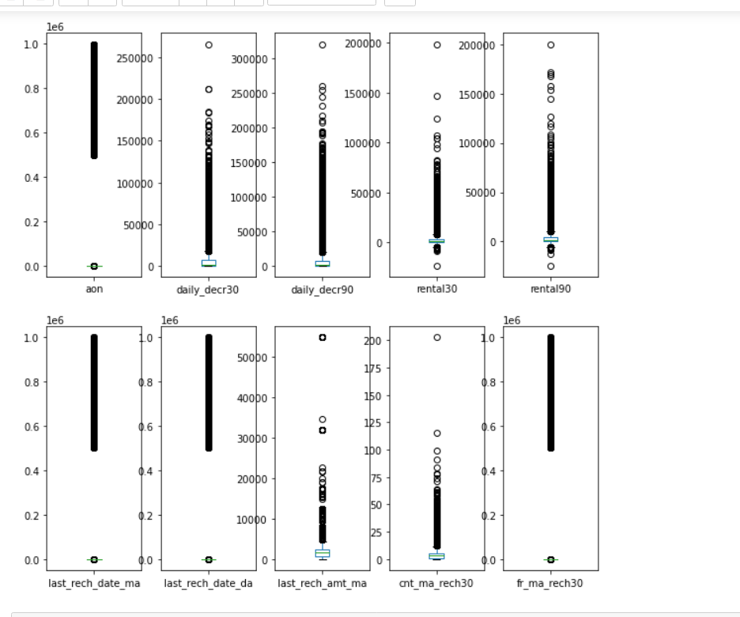
Box plot is a good way of visualising the outliers in the data ,there are outliers present in this data ,however in attempt of removing the outliers we would loose more than 25% of data so have to let it stay as it is .we can not afford to loose so much of data .

Slide 10
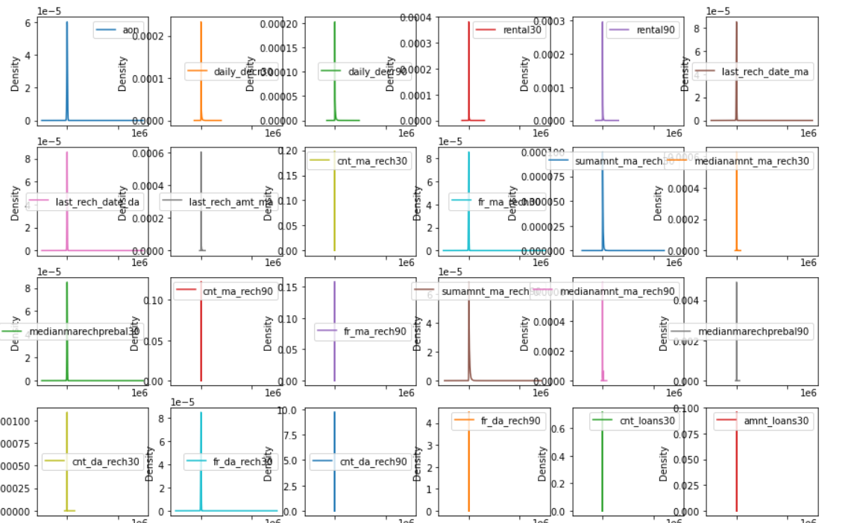
Kernal density plots – To check the data distribution we can use kde plots ,I have applied kde to all the columns to check the spread of data

Slide 11
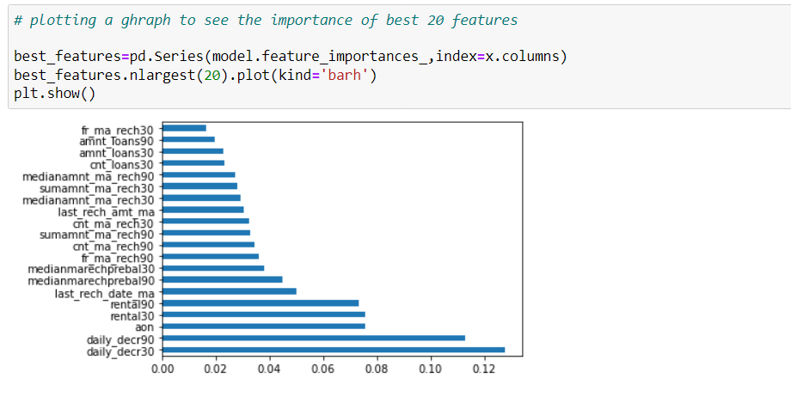
Showing the best features on graph

Slide 12
Model Comparison Top 3 Models
Logistic Regression
AccuracyScore-87.4%
Random Forest
Accuracy Score-91.1%
Gradient Bost
Accuracy Score
90.7%

Slide 13
Potential Benefits
The predictive model will help the client to figure out the customer pattern and the history of transactions.
It will be highly beneficial for the client as it will prevent them to give loans to the fraudlent accounts.
With the help of user friendly dashboard the client will just have to insert few details of the loan applicant and with submit button the client will get a prediction that the loan should be processed to that particular account or not.
Thus it will help in better decision making and will save time and resourses.

